Slide 1
Chapter 6 Heapsort
Hsu, Lih-Hsing

Slide 2
Why sorting
1. Sometimes the need to sort information is inherent in a application
2. Sorting is a key subroutine of most algorithms
3. There is a wide variety of sorting algorithms, and they use rich set of techniques
4. Sorting problem has a nontrivial lower bound
5. Many engineering issues come to fore when implementing sorting algorithms

Slide 3
Sorting algorithms
Insertion sort :
In place: only a constant number of elements of the input array are even sorted outside the array
Merge sort :
not in place.
Heap sort : (Chapter 6)
Sorts n numbers in place in O(n log n) time

Slide 4
Sorting algorithms
Quick sort : (chapter 7)
Worst-case: O(n²)
Average-case: O(n log n)
Decision tree model : (chapter 8)
Lower bound: O(n log n)
Counting sort
Radix sort
Order statistics: Finding the k-th largest (smallest) job

Slide 5
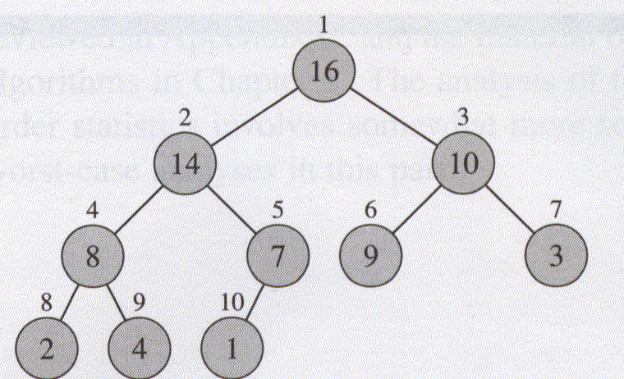
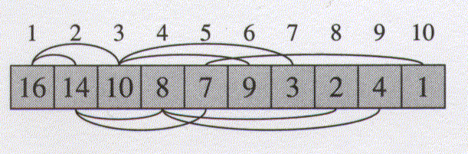

6.1 Heaps (Binary heap)
The binary heap data structure is an array object that can be viewed as a complete tree.
Conceptual
structure
Parent(i)
return
LEFT(i)
return 2i
Right(i)
return 2i+1
$$\left\lfloor i/2\right\rfloor$$
Physical
structure

Slide 6
Heap property
Max-heap : A[parent(i)] ≥ A[i]
Min-heap : A[parent(i)] ≤ A[i]
The height of a node in a tree: the number of edges on the longest simple downward path from the node to a leaf.
The height of a tree: the height of the root
The height of a heap: O(log n).

Slide 7
Basic procedures on heap
Max-Heapify procedure
Build-Max-Heap procedure
Heapsort procedure
Max-Heap-Insert procedure
Heap-Extract-Max procedure
Heap-Increase-Key procedure
Heap-Maximum procedure

Slide 8
6.2 Maintaining the heap property
Heapify is an important subroutine for manipulating heaps
Its inputs are an array A and an index i in the array.
When Heapify is called, it is assume that the binary trees rooted at LEFT(i) and RIGHT(i) are heaps, but that A[i] may be smaller than its children, thus violating the heap property
Inherent recursion

Slide 9
Max-Heapify (A, i)
1 l ← Left (i)
2 r ← Right(i)
3 if l ≤ heap-size[A] and A[l] > A[i]
4 then largest ← l
5 else largest ← i
6 if r ≤ heap-size[A] and A[r] > A[largest]
7 then largest ← r
8 if largest ≠ i
9 then exchange A[i] ↔ A[largest]
10 Max-Heapify (A, largest)
Alternatively O(h), where h denotes the height)

Slide 10
6.3 Building a heap
Given an array of keys, we are constructing a Max-heap of the keys.
Build-Max-Heap(A)
1 heap-size[A] ← length[A]
2 for i ← ⎣length[A]/2⎦ downto 1
3 do Max-Heapify(A, i)

Slide 11
Loop Invariant
At the start of each iteration of the for loop of lines 2-3, each node i+1, i+2, . . . , n is the root of a max-heap
Initialization
Maintenance
Termination

Slide 12
Max-heapifying a node takes O(h)=O(log n) time
Building a heap = Max-heapifying n nodes
takes O(n log n) time?

Slide 13
6.4 The Heapsort algorithm
Heapsort(A)
1 Build-Max-Heap(A)
2 for i ← length[A] down to 2
3 do exchange A[1]↔A[i]
4 heap-size[A] ← heap-size[A] -1
5 Max-Heapify(A, 1)

Slide 14

1
2
3
4
5
6
7
8
9
10
Input an array
10
7
1
3
9
4
8
14
16
2
Build Max heap
Physical Structure
of a Max heap
Output Max’s
Sorted array

Slide 15
7.5 Priority queues
A priority queue is a data structure that maintains a set S of elements, each with an associated value called a key
A max-priority queue supports the following operations:
Insert (S, x) O(log n)
Maximum (S) O(1)
Extract-Max (S) O(log n)
Increase-Key (S, x, k) O(log n)

Slide 16
Heap_Extract-Max(A)
1 if heap-size[A] < 1
2 then error “heap underflow”
3 max ← A[1]
4 A[1] ←A[heap-size[A]]
5 heap-size[A] ← heap-size[A] - 1
6 Max-Heapify (A, 1)
7 return max

Slide 17
Heap-Increase-Key (A, i, key)
1 if key < A[i]
2 then error “new key is smaller than current key”
3 A[i] ← key
4 while i > 1 and A[Parent(i)] < A[i]
5 do exchange A[i] ↔ A[Parent(i)]
6 i ← Parent(i)

Slide 18
Heap_Insert(A, key)
1 heap-size[A] ← heap-size[A] + 1
2 A[heap-size[A]] ← -∞
3 Heap-Increase-Key (A, heap-size[A], key)

Slide 19
Questions
Will two distinct permutations (inputs) lead to the same Max heap?
Consider the context of dynamic arrivals and departures

